Slide 1


Freedom. Flexibility. Opportunity.
Information Workshop for NAFA Advisors
2024 Selection Cycle

Slide 2

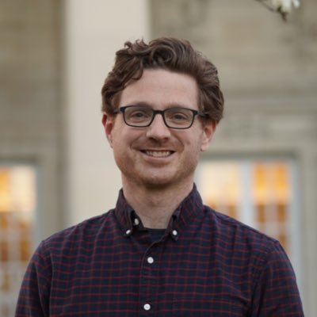
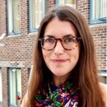
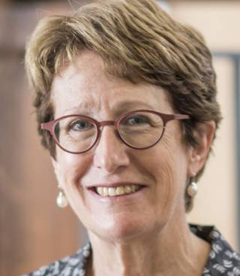
Who We Are
Josh Stanton
Head of Strategic Communication
British Embassy Washington
Haley Addison
Manager
Marshall Aid Commemoration Commission (MACC)
Prof. Frances Brodsky (‘76)
Professor of Cell Biology, UCL
SF Regional Selection Committee Member

Slide 3
Who are
Marshall Scholars?

Slide 4
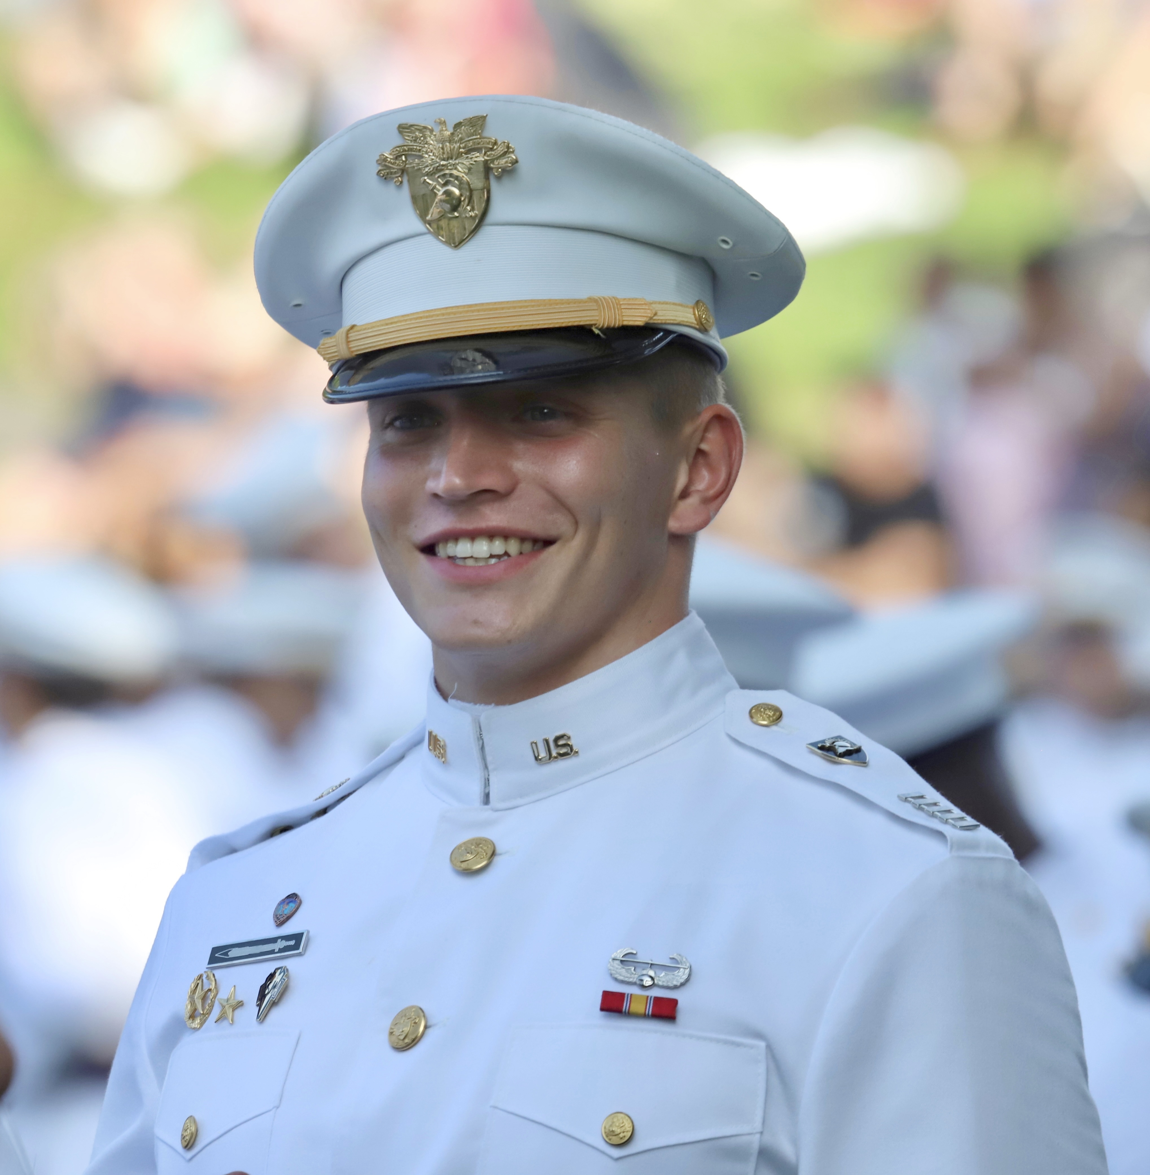
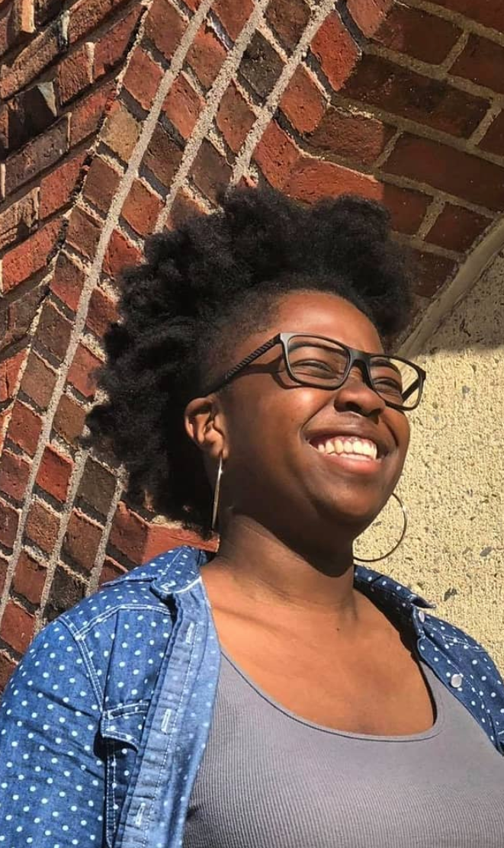
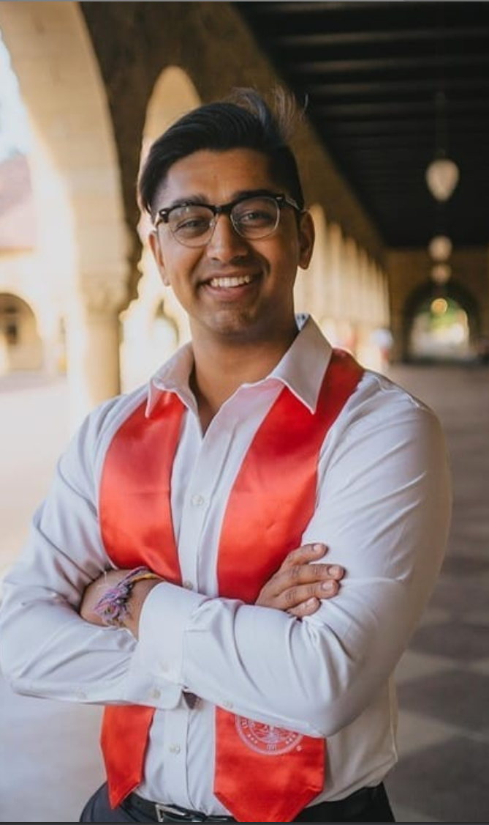
Soldiers
Advocates
Innovators

Slide 5

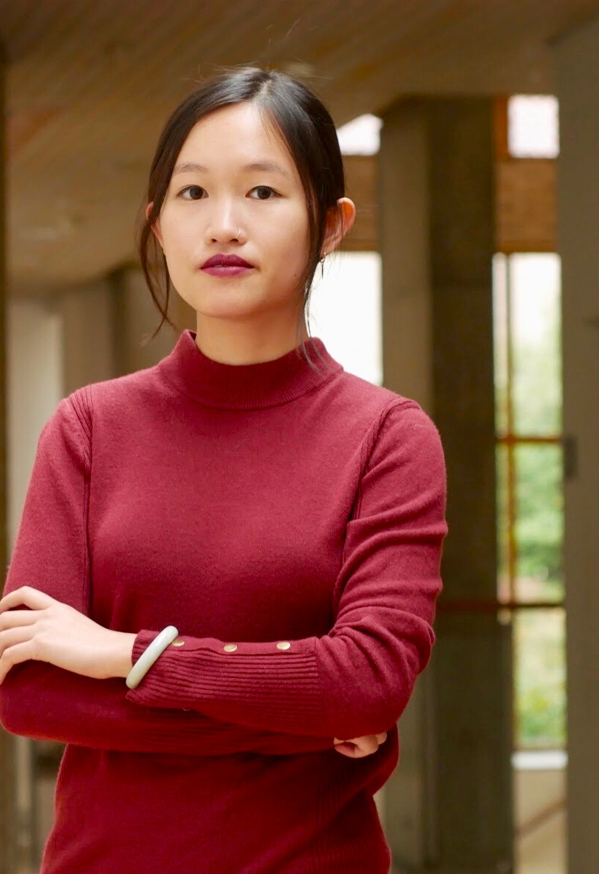
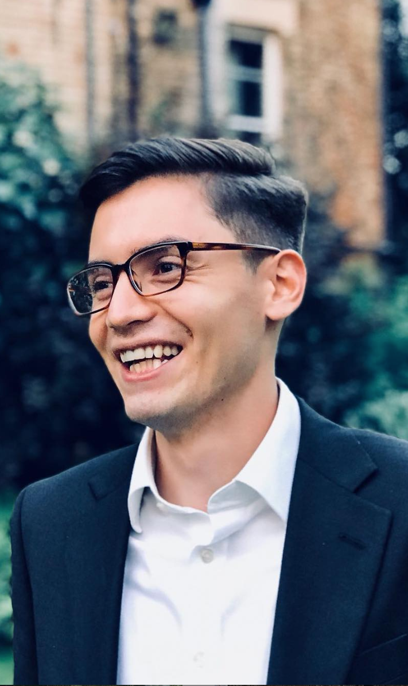
Musicians
Authors
Community
Leaders

Slide 6
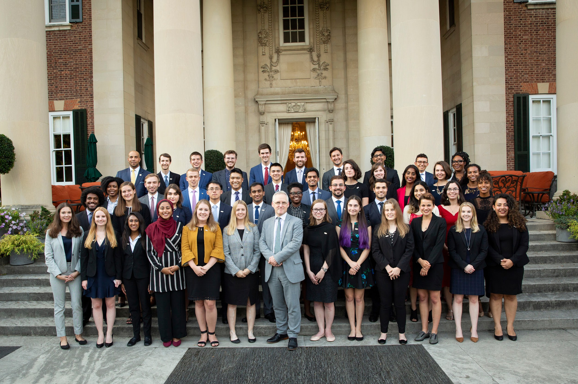
A Diverse Community

Slide 7
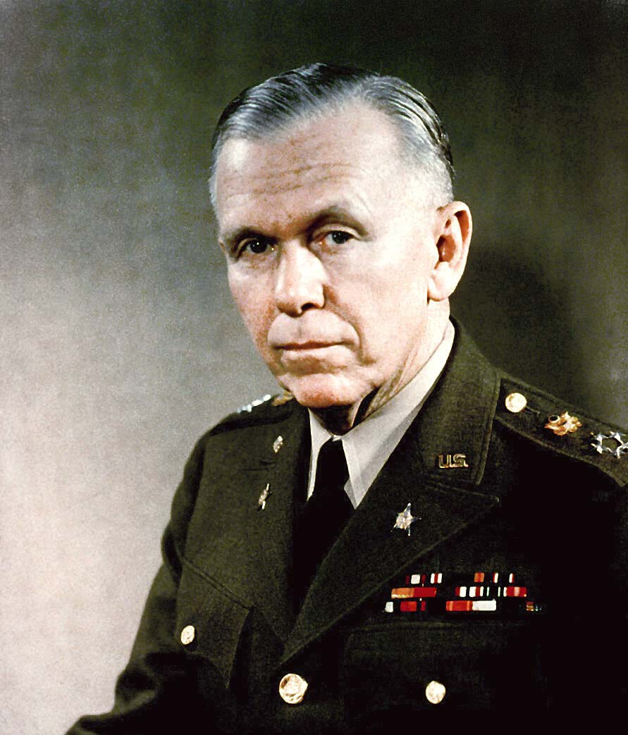

A Brief History
Established in 1953
The British Parliament created the programme as a thank you for US economic aid under the ”Marshall Plan”
Goal: ”To enable intellectually distinguished young Americans, who will become their country’s future leaders and decision makers, to study in the UK.”
General George C. Marshall

Slide 8

Eligibility
You must have graduated from your undergraduate institution after April 2020
You must hold your first undergraduate degree from an accredited 4-year institution by September 2023.
You must be a US Citizen;
You must hold an undergraduate GPA of 3.7 or higher at time of application and graduation.
You must not have studied or hold a degree equivalent qualification from a UK university, GSCE or A-levels taken at a school in the UK (study abroad OK)

Slide 9
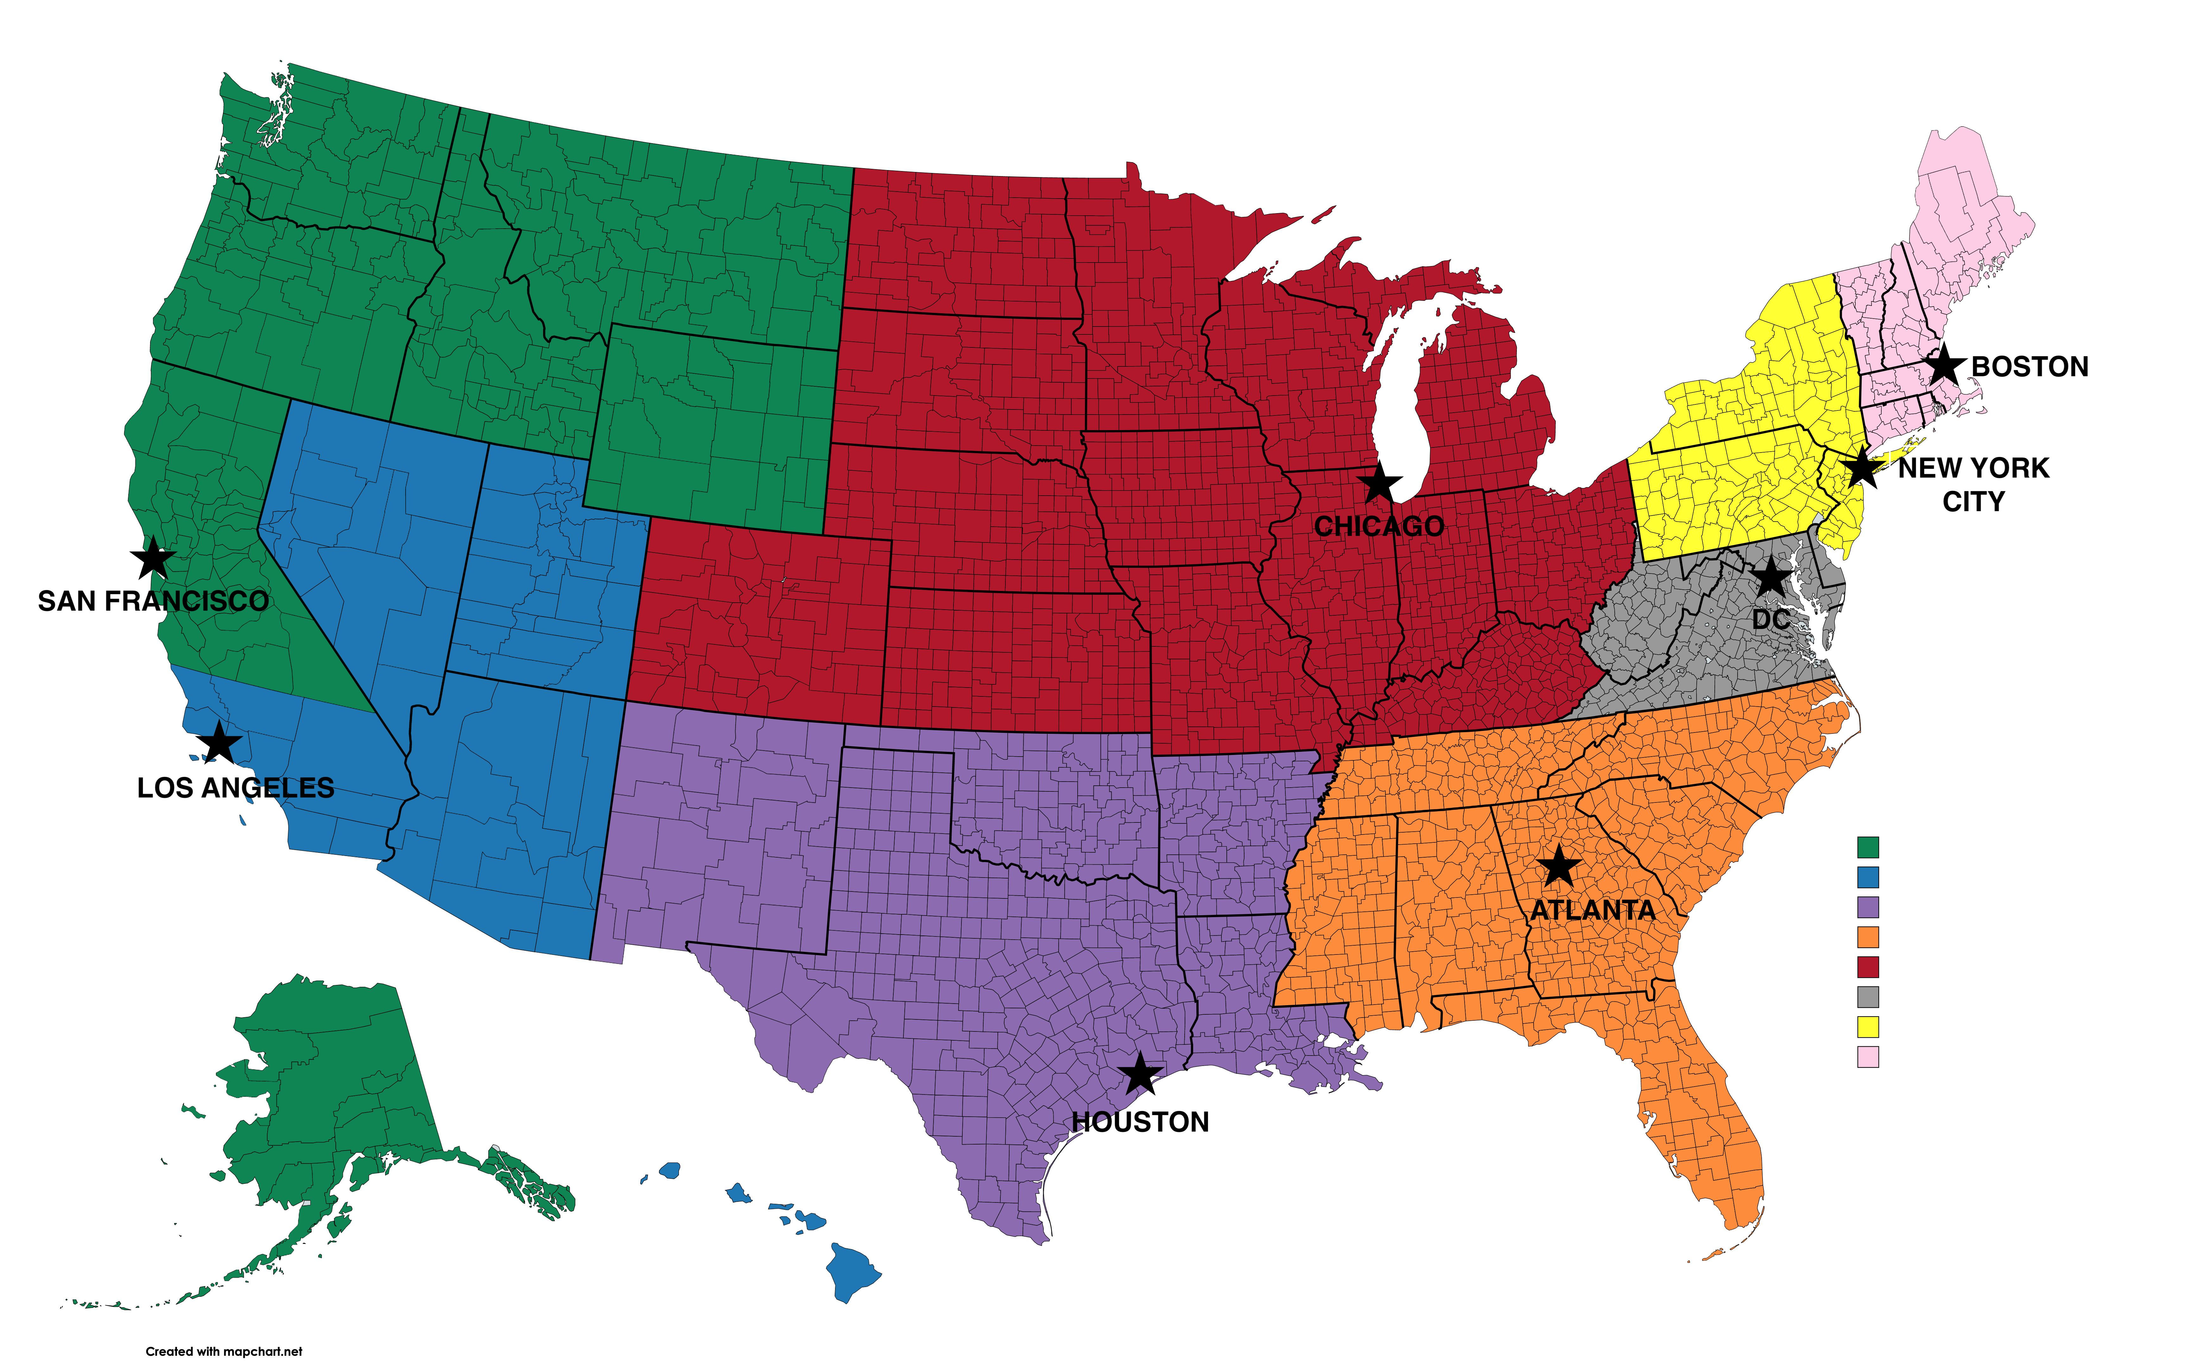
Application Regions
You can apply in region of…
Permanent home address
Undergraduate institution
Students can apply through one of the following consulates:
Atlanta
Boston
Chicago
Houston
Los Angeles
New York
San Francisco
Washington, DC (Embassy)

Slide 10


Application Components
Basic Form & Short Answer
Essays
Transcripts
University’s Endorsement
3 Letters of Recommendation

Slide 11
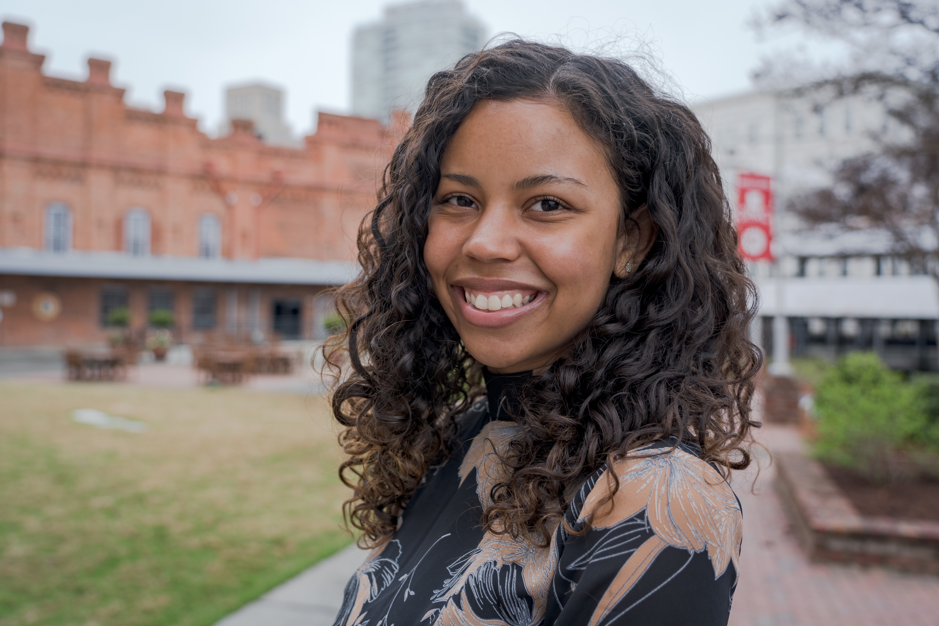
Academic Merit
Evidence of strong & relevant academic background
Knowledge of proposed courses and supervisors
Quality of programs of study
Quality & breadth of recommendations

Slide 12

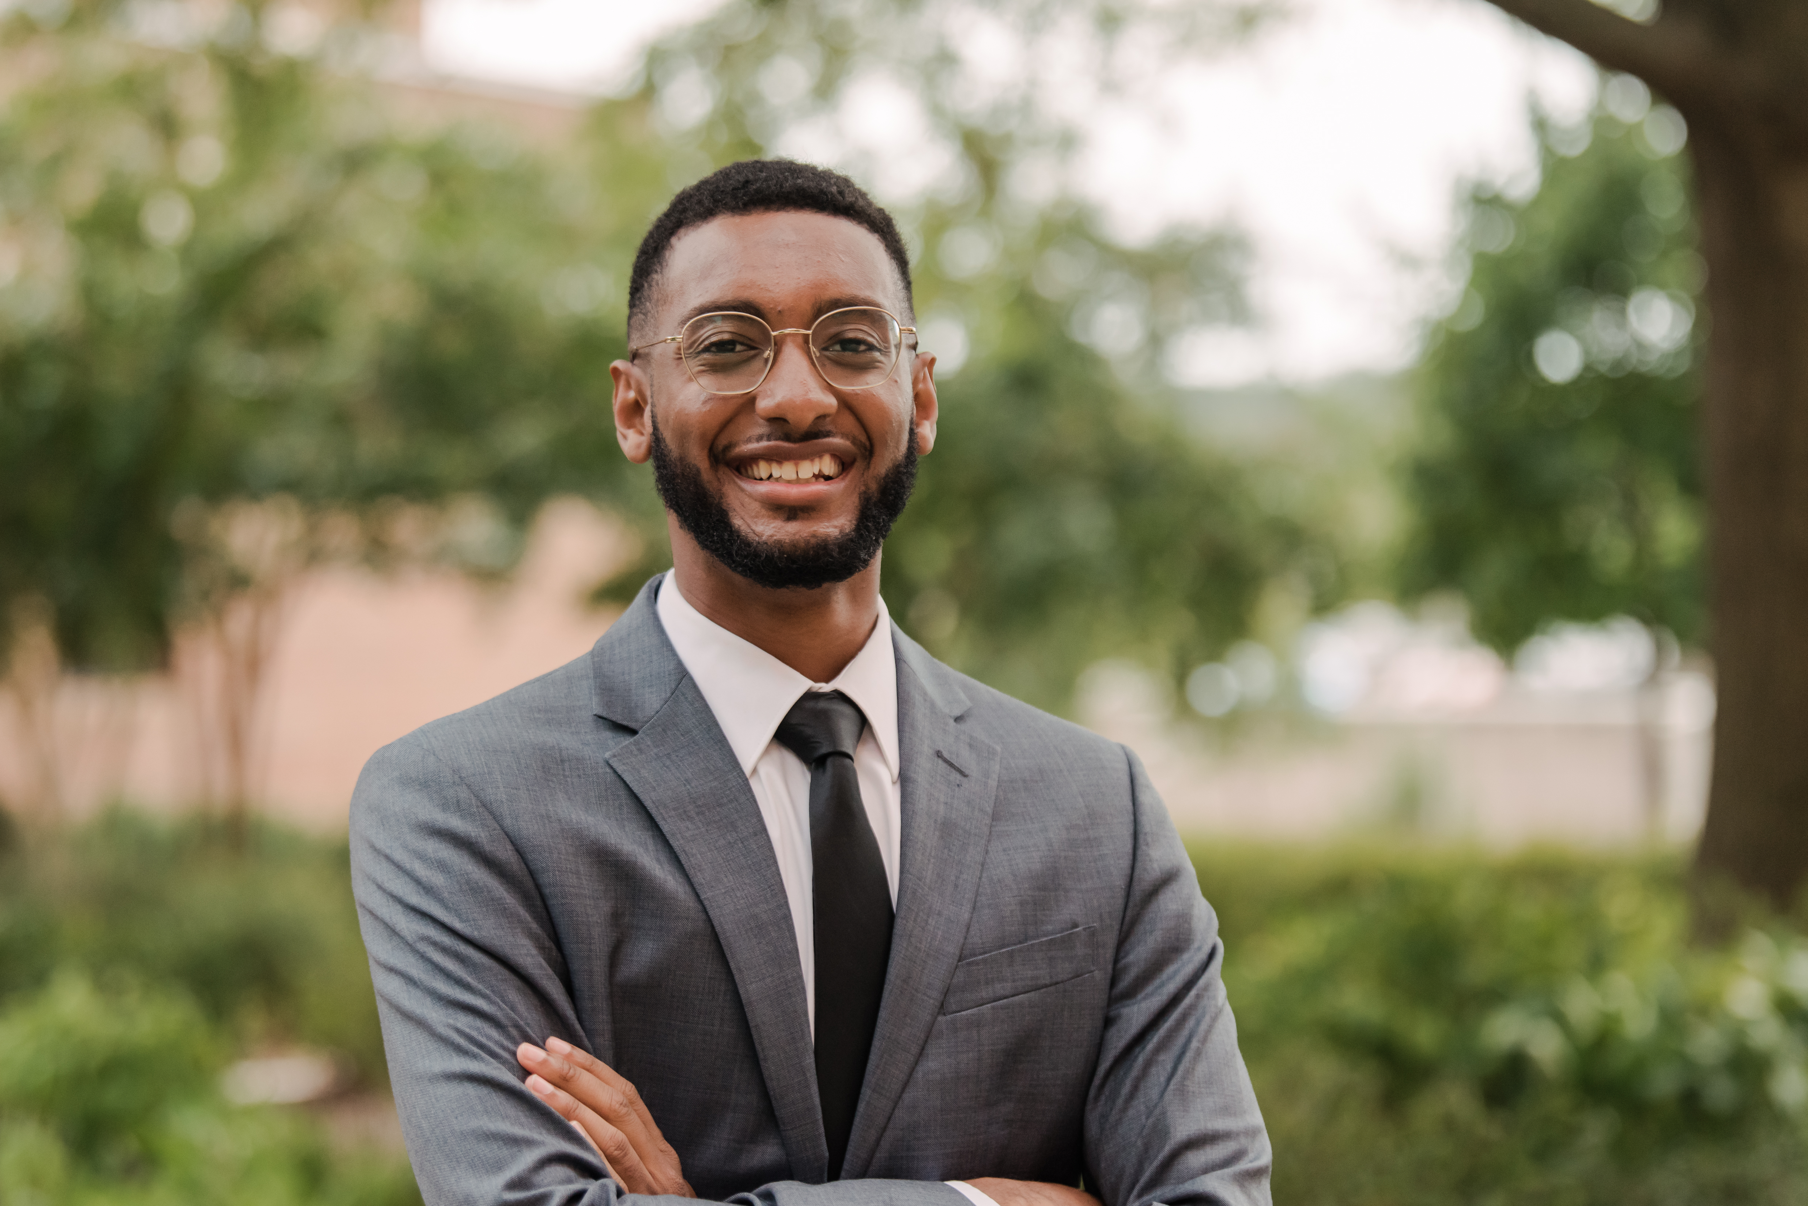
Leadership Potential
Ability to deliver results
Strength of Purpose
Creativity
Self-Awareness

Slide 13
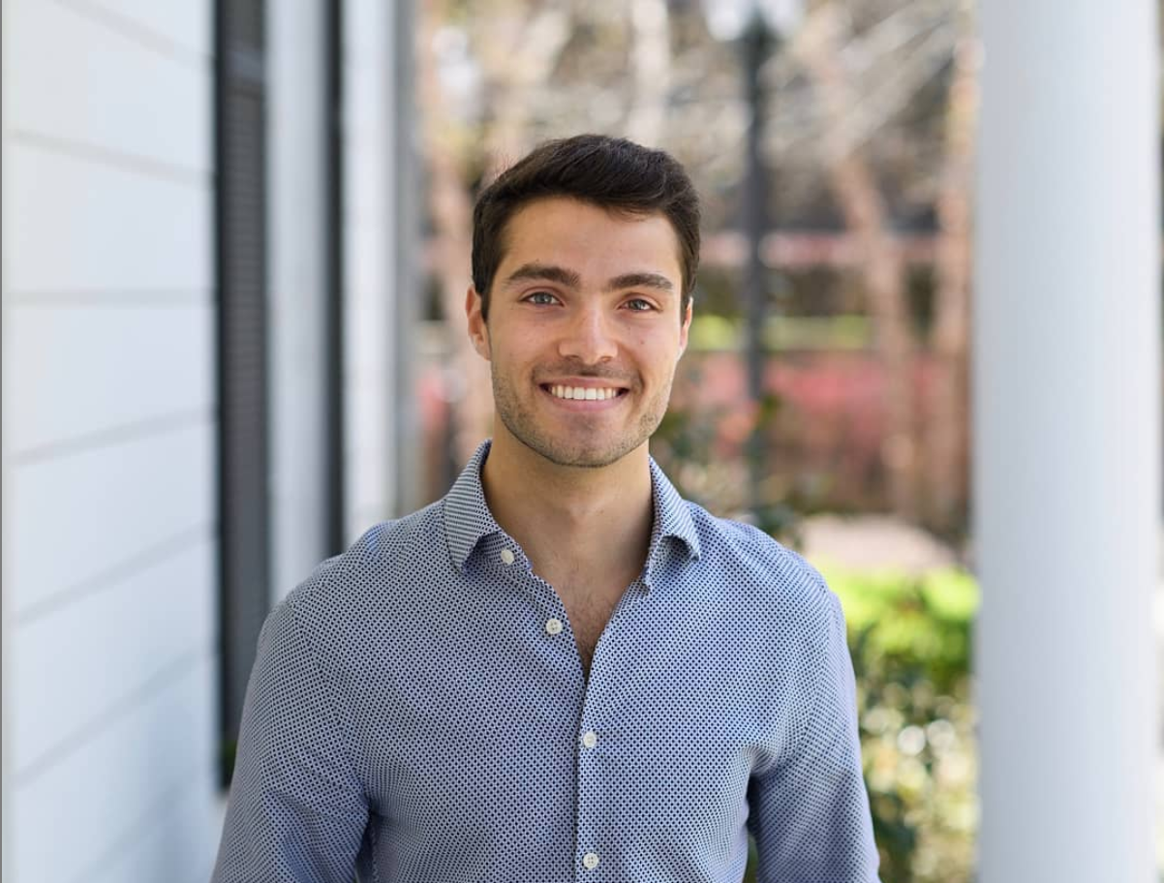
Ambassadorial Potential
Knowledge of US-UK relations
Evidence of
Transferable extra-curriculars
Interpersonal skills &
Ability to engage others
Confidence & ability to
seize opportunities

Slide 14
Route Map
One-Year Scholarship
12 month Master’s
Research or Taught
No extension
Two-Year Scholarship
Two 1-year Master’s at same or different university OR
One 2-year Master’s OR
At least 2 years of PhD
Two-Year Scholarship w/ possible 3rd year extension
Complete 1 year Master’s; Start PhD in Year 2
Upgrade from 2-year research Master’s*
Continue 2 previous years of PhD*
*Third year funding is possible, but not guaranteed; students must apply during their 2nd year. See website for more details.

Slide 15

Scholarship Timeline
Early Dec
Winners announced
Mid-Late Oct
Shortlist Meetings
Last week of Sept
Application deadline
Early Nov
Interviews

Slide 16

Interviews
30 minutes long at their local consulate
Travel costs are covered by the Marshall Commission (no international flights)
All committee members are American and most are Marshall Scholars (though not a requirement)
All thematic areas of expertise covered by selection committee

Slide 17
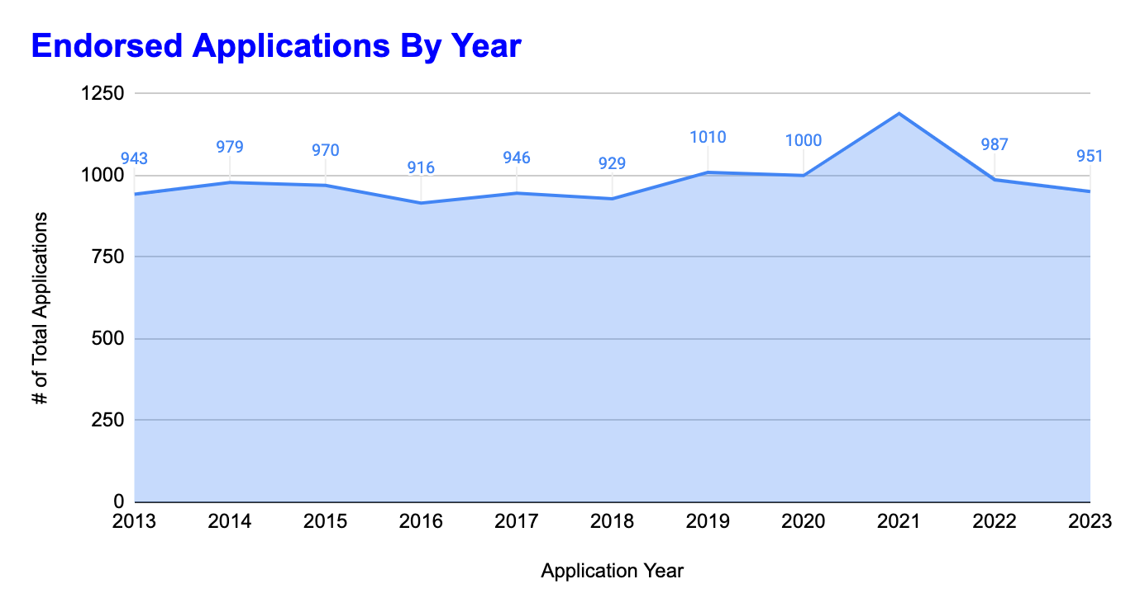
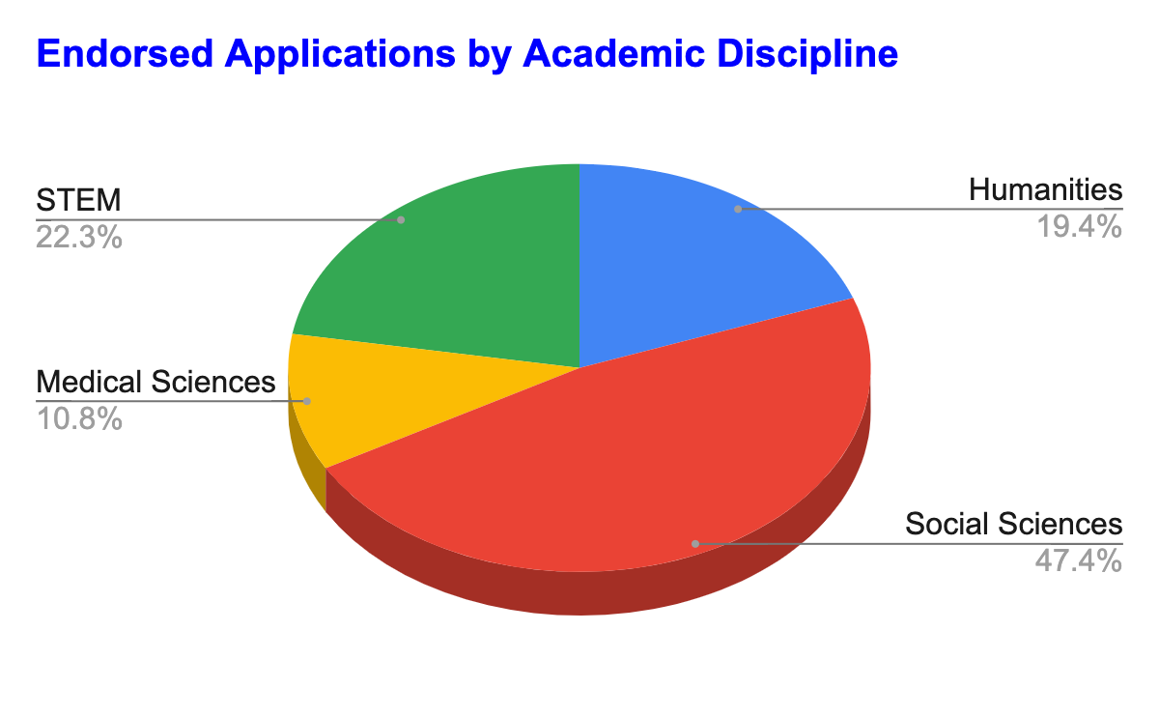
2023 Application Cycle at a Glance
1190

Slide 18
2023 Class at a Glance
40 scholars selected nationwide.
55% of class were women, continuing trend of female-majority classes for five of last six classes.
40% of class identified as BIPOC
30% of class is Pell Grant eligible

Slide 19
2022 Class at a Glance
Type of University | Endorsed | Interviewed | Selected
Private (Research & Liberal Arts) | 46.2% | 40.3% | 38.2%
State/Public | 33.3% | 34.4% | 29.4%
Ivy League | 15% | 16.2% | 11.8%
Service Academies | 4.4% | 9% | 17.7%

Slide 20
2023 Class at a Glance
Preferred UK Destination | Selected
Oxford & Cambridge | 51%
London Universities | 27%
Other Universities in England | 22%
Unis in Scotland, Wales and Northern Ireland | 0%
Tip: Your preferred UK university should be based on the type and strength of the degree programme you’re seeking

Slide 21
5 Tips for Choosing a UK University
1. Encourage your candidates to do research
Why your candidates choose to apply for a university matters greatly to selection committees. They should conduct thorough research on programmes in their academic field to choose a school they believe will best support their academic and professional goals.
2. Encourage your applicants to talk to UK professors
UK universities are home to some of the world’s leading researchers and professors. Reaching out to professors for information, advice or to seek assistance in developing a research plan can make a difference in demonstrating a strong academic plan to committees.
3. Consider universities outside London/Oxbridge
The best programme for your candidates’ interests might not always be found in London, Cambridge or Oxford. Many others UK universities offer a tailored academic experience and would allow them to discover everything that makes British culture so unique. Encourage them to consider our Marshall Partnership Universities.
4. Develop an academic plan
Help them develop a plan that demonstrates in their application (and to the selection committee) how they plan to make the most of their time in the UK.
5. Remember, they can apply anywhere!
The Marshall Scholarship enjoys partnership agreements with a host of British universities and colleges, who all subsidize or fully cover the costs of a scholarship. This effectively allows them to apply for any university in the country. The more that Marshall Scholars go to partner schools, the more scholarships we are able to offer on a yearly basis.

Slide 22
Partnership Schools
Keele University
University of Kent
King's College, Cambridge
King's College London
University of Leeds
Lincoln College, Oxford
University of Liverpool
London School of Economics
& Political Science
London School of Hygiene
& Tropical Medicine
Magdalen College, Oxford
Magdalene College, Cambridge
University of Manchester
New College, Oxford
Newcastle University
Newnham College, Cambridge
University of Nottingham
Nuffield College, Oxford
Oriel College, Oxford
Queen Mary University of London
Queen's University Belfast
Balliol College, Oxford
University of Bath
University of Birmingham
University of Bradford
University of Bristol
Christ Church, Oxford
Christ’s College, Cambridge
Cardiff University
University of Dundee
(College of Life Sciences)
(PhD only)
Durham University
University of East Anglia
University of Edinburgh
University of Exeter
Exeter College, Oxford
University of Glasgow
Gonville & Caius, Cambridge
Guildhall School of Music & Drama
University of Hull
Imperial College London
University of Reading
Pembroke College, Cambridge
Royal Holloway
Royal Northern College of Music (PhD Only)
School of Oriental
& African Studies (SOAS)
University of Sheffield
Somerville College, Oxford
University of Southampton
University of St Andrew's
St. John's College, Cambridge
University of Surrey
University of Sussex
Trinity College, Cambridge
Trinity College, Oxford
University College, Oxford
University College London
University of Warwick
University of York
3rd year partner:
University of Cambridge
University of Oxford

Slide 23

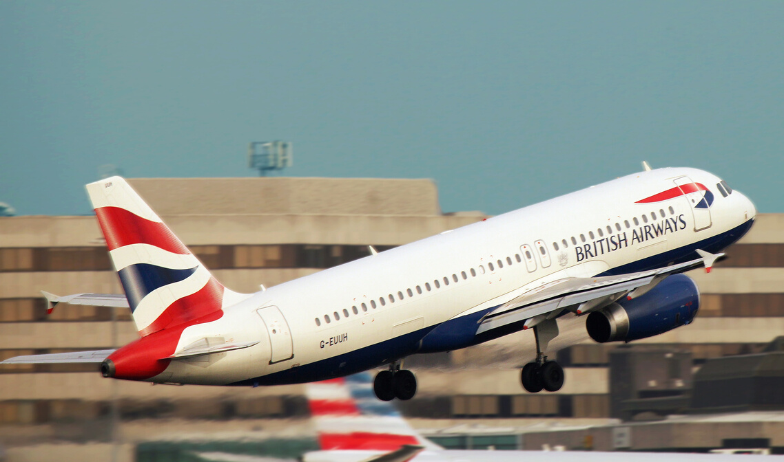


Scholarship Benefits
Full payment
of tuition
Airfare
To/from the US
Living Allowance
Claimable Allowance
Up to $4000 for:
Approved travel in connection with studies
Commuter travel
Thesis prep
Shipping property to/from the US

Slide 24
Consular Contacts
Consulate/MACC | Name | Email Address
Atlanta | Sydnie Hammond | Sydnie.Hammond@fcdo.gov.uk
Boston | Rachel Guerra (neé Wells) | Rachel.Wells@fcdo.gov.uk
Chicago | Daniel Shea | Daniel.Shea@fcdo.gov.uk
Houston | Elizabeth Bertram | Elizabeth.Bertram@fcdo.gov.uk
Los Angeles | Maya Angulo | Maya.Angulo@fcdo.gov.uk
New York City | Nick Murray | Nicholas.Murray@fcdo.gov.uk
San Francisco | Christopher Cambises | Christopher.Cambises@fcdo.gov.uk
Washington, DC | Josh Stanton | Joshua.Stanton@fcdo.gov.uk
Miami (Outreach in FL, PR and USVI only) | Alex Miles | Alexander.Miles@fcdo.gov.uk
MACC | Haley Addison | Haley.Addison@acu.ac.uk

